Slide 1
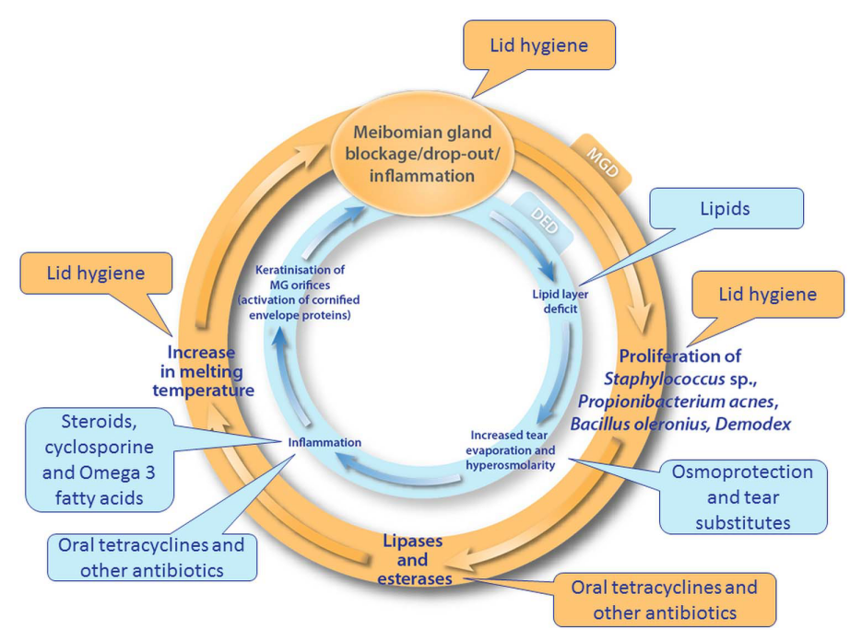
瞼板腺功能障礙的治療方式 – 補充脂質層
Lipid-based eye drops are demonstrated to decrease tear film osmolarity and improve tear film stability more effectively than water-based eye drops in patients with mild to moderate EDE.
Oil-in-water emulsions reduce the signs and symptoms of all types of dry eye, but are particularly recommended for lipid-deficient dry eye patients.
Curr Eye Res. 2022 Jun;47(6):813-823. doi:10.1080/02713683.2022.2039205.
Br J Ophthalmol 2016;100:300–306. doi:10.1136/bjophthalmol-2015-307415.
Notes:
Curr Eye Res. 2022 Jun;47(6):813-823. doi: 10.1080/02713683.2022.2039205.

Slide 2
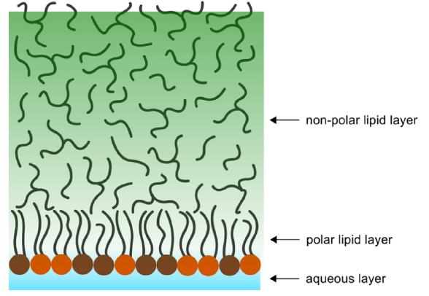
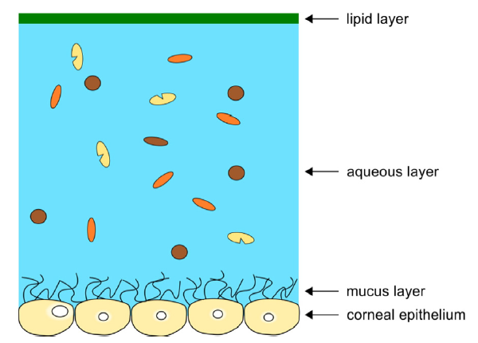
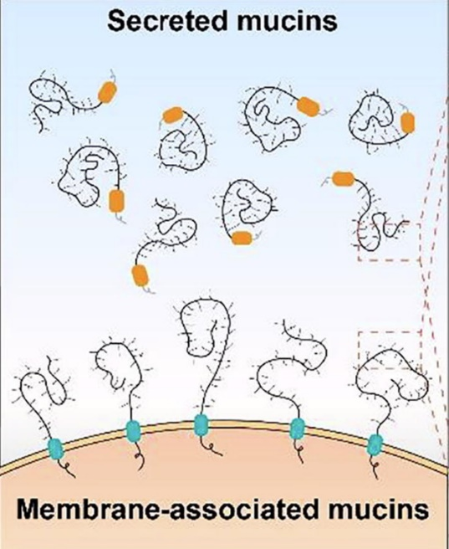
Important Surfactants in Tear Film
phospholipid
main constituent of the polar sub-layer that resides at the aqueous-lipid interface stabilizing both TFLL and the aqueous tear
enable hydrophilic
spreading of the tear film, facilitating lubrication,
and minimizing discomfort
converting the hydrophobic plasma membrane to a hydrophilic
surface
References: 1 Elsevier Recombinant mucin biotechnology and engineering ； Tear film lipid layer: A molecular level view
Notes:
Mucins in the aqueous layer also act as surfactants to diffuse lipids over the aqueous layer, preventing excessive evaporation of the tear ﬂuid.

Slide 3
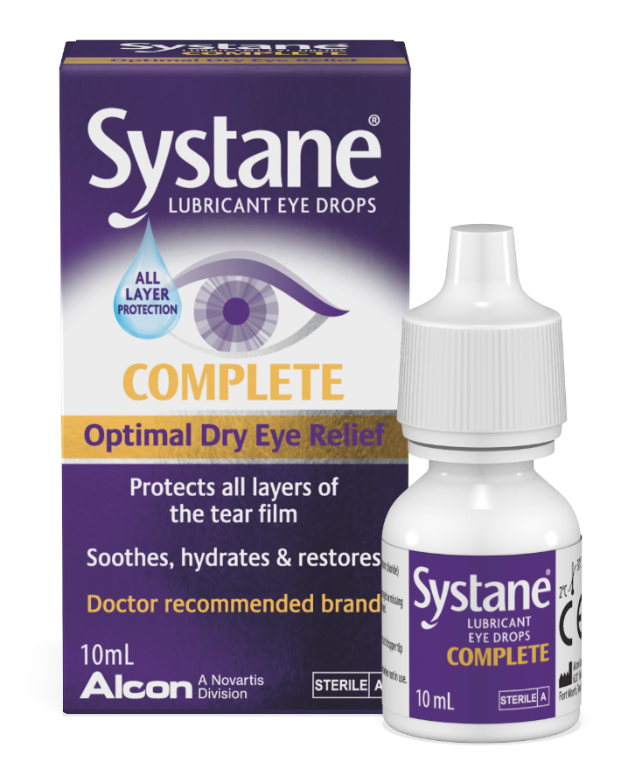
Innovative Comprehensive Therapeutic Artificial Tears
Systane Complete 視舒坦康復力
創新全效型人工淚液
最接近自然淚液的人工淚液
創新藥物傳遞系統Nanoemulsion
References: 1. Ketelson H, Rangarjan R. Pre-clinical evaluation of a novel phospholipid nano emulsion based lubricant eye drops. Poster presented at ARVO 2017, Baltimore, MD. 2. Rangarajan R, Ketelson H. Preclinical evaluation of a new hydroxypropyl-guar phospholipid nano emulsion-based artificial tear formulation in models of corneal epithelium. J Oculi Pharmacol Ther. 2019;35(1):32-37.

Slide 4

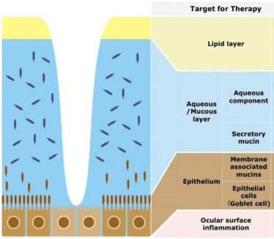
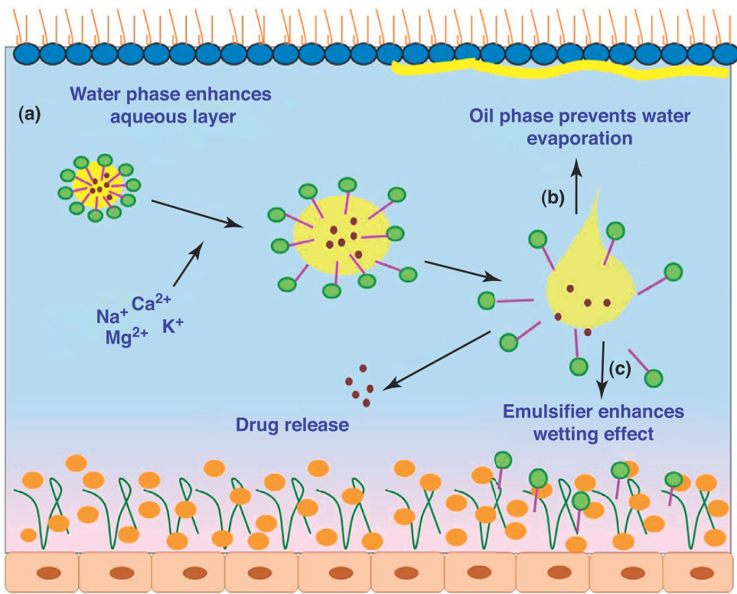
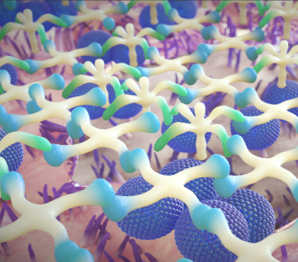
Most Resemble to Natural tears
Anionic Phospholipids
Nano-sized lipid droplets
Replenish the lipid layer of the tear film.¹
Mineral oil
Phospholipid
Mineral Oil
PG (Propylene-Glycol)
HP-Guar
Increases mucous layer thickness and protects the ocular surface^{1,3}
HP-Guar
Reference: Wolffsohn JS, Arita R, Chalmers R, et al. TFOS DEWS II Diagnostic Methodology report. Ocul Surf. 2017;15(3):539-574.
Ketelson H, Rangarjan R. Pre-clinical evaluation of a novel phospholipid nano emulsion based lubricant eye drops. Poster presented at ARVO 2017, Baltimore, MD. 2. Rangarajan R, Ketelson H. Preclinical evaluation of a new hydroxypropyl-guar phospholipid nano emulsion-based artificial tear formulation in models of corneal epithelium. J Oculi Pharmacol Ther. 2019;35(1):32-37.
Notes:
成分內含有Phospholipid作為界面活性劑，包覆住礦物油，形成水包油的結構，讓油滴能緊密貼附在水層之上，同時奈米大小的油滴有助於滲透到Lipid layer的微小空隙中做填補。
Anionic polar phospholipids in lubricant drops act as surfactants and provide a stable interface between neutral nonpolar lipids and the aqueous layer thereby replenishing and stabilizing the lipid layer, improving lipid layer thickness, and meibomian gland functionality.
PG作為保濕因子(demulcent)，填補水層
HP-Guar與borate形成凝膠狀聚合網鏈結的排列後可以更加全面的將保濕因子PG包覆其中，覆蓋在黏液層上，延長在眼表的停留時間
此外HP Guar本身有增厚黏液層的效果
補充藥物的釋放機轉 Drug Discov Today. 2013 Mar;18(5-6):290-7. doi: 10.1016/j.drudis.2012.10.005.

Slide 5
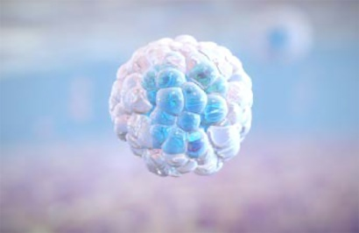
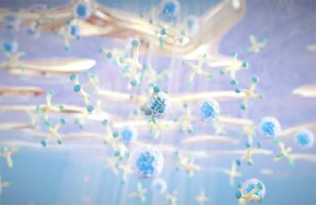
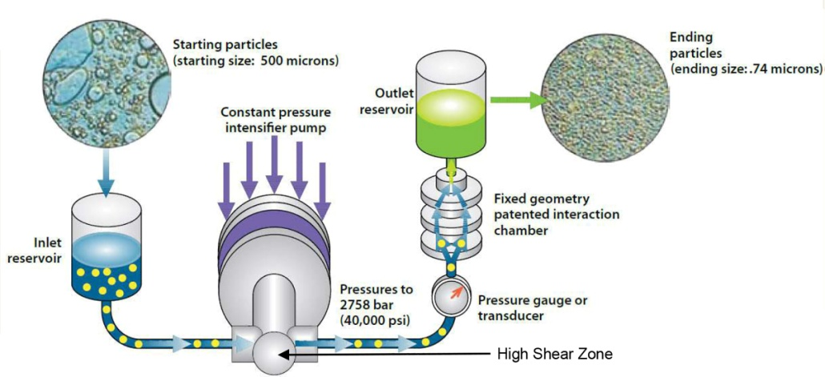
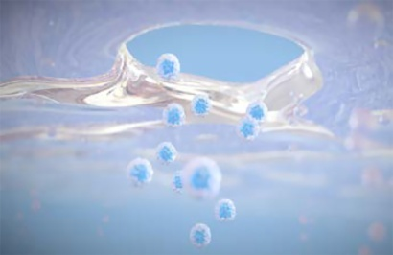
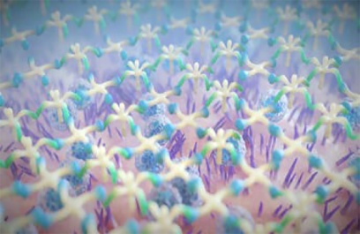
Microfluidizer® technology¹
Microfluidizer® is capable of generating pressures up to 30,000 psi with flow rates up to 125 mL/minute
Microfluidics’ fixed-geometry chambers and constant pressure pumping system provide a uniform processing environment for the entire product volume and guarantees scale up of the chambers
Nano-sized lipid droplets in formulation²
PG/HPG-nanoemulsion upon instillation²
Nano-sized lipid droplets replenishing the lipid layer²
HPG/borate complex²
3X more HP-Guar
compared to Systane Balance
HPG, hydroxypopylguar; MDPF, multidose preservative free; PG, propylene glycol
References: 1. Alcon data on file, 2017. 2. Ketelson H, Rangarjan R. Pre-clinical evaluation of a novel phospholipid nanoemulsion based lubricant eye drops. Poster presented at ARVO 2017, Baltimore, MD.
Notes:
The increased concentration of HPG (compared with Systane® Balance) in this PG-HPG nanoemulsion allows better cross linking with borate ions, improving the retention of the lubricant (PG) within the aqueous/mucin layer and moisture content of the deficient aqueous tear film.
The smaller nano-sized lipid droplets also optimize the lipid surface coverage and make the emulsion formulation less opaque (ie, translucent), improving ocular surface coverage and minimizing blurring, helping to provide the instant (at 0 hour) and sustained symptom relief over an
8-hour period.

Slide 6
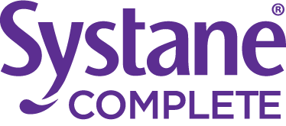
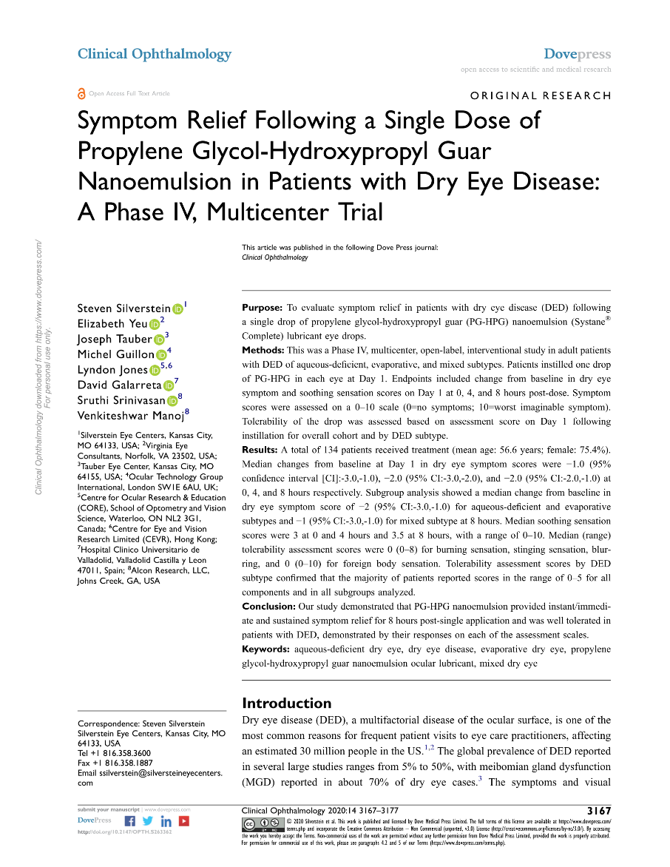





Symptom Relief Following a Single Dose of
PG-HP Guar Nanoemulsion in Patients with Dry Eye Disease
To evaluate symptom relief in patients with dry eye disease (DED) following a single drop of propylene glycol-hydroxypropyl guar (PG-HPG) nanoemulsion (Systane® Complete) lubricant eye drops
A total of 134 patients received treatment
Baseline (pre-dose) and 0 hours (i.e., immediately after dosing) in patients and at 4 (±1) and 8 (±1) hours post-dose on the telephone on the same day
Patients instilled one drop of PG-HPG Nano-emulsion in each eye
Patient-reported outcome (PRO) assessment using a Likert scale
Dry eye symptom score (0-10) , Soothing sensation (0-10)
Clinical Ophthalmology 2020:14 3167–3177. doi:10.2147/OPTH.S263362.

Slide 7
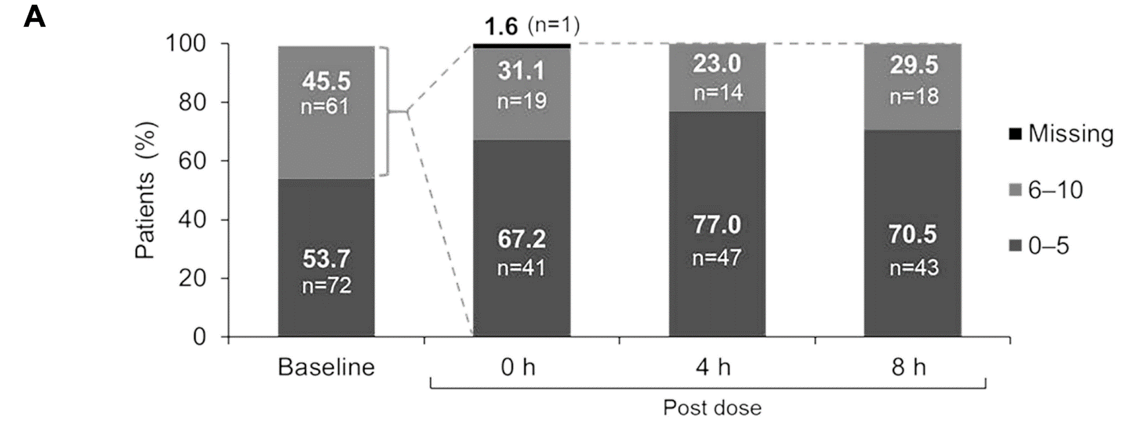

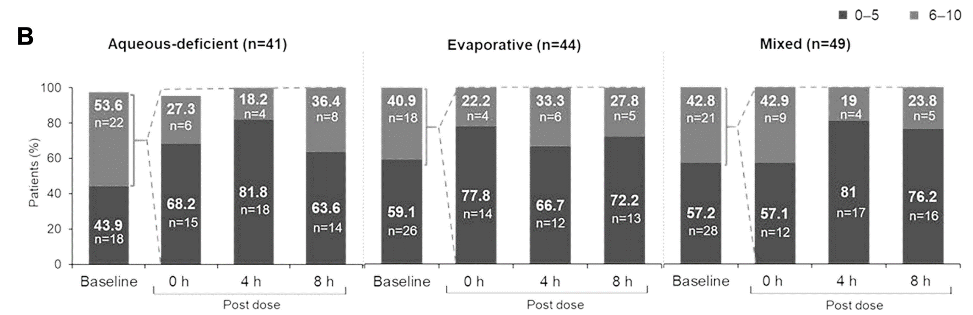
To relieve symptoms of dry eye (Dry Eye Symptom Scores)
Over 70% of patients reported significant symptom relief through 8 hours^{1*}
Over 63% of patients across all Dry Eye sub-types reported significant relief after a single dose of Systane® COMPLETE^{1*}
Especially better improvement in
Evaporative and mixed type dry
Eye patients.
Clinical Ophthalmology 2020:14 3167–3177. doi:10.2147/OPTH.S263362.

Slide 8
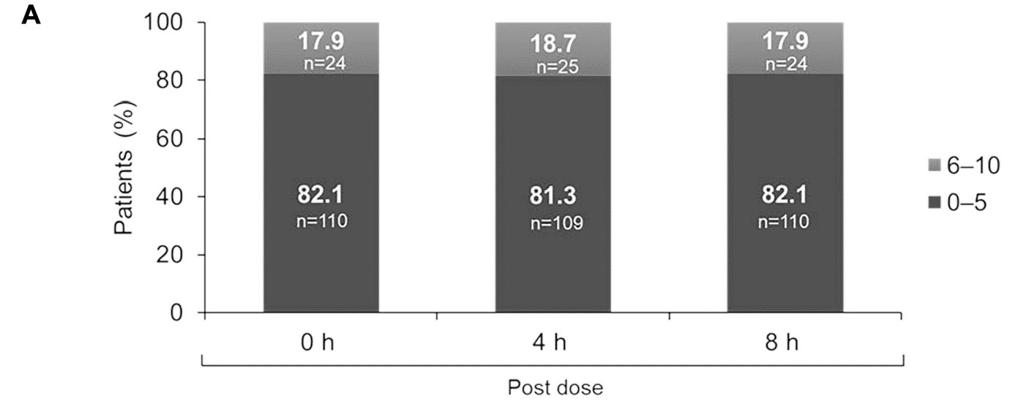
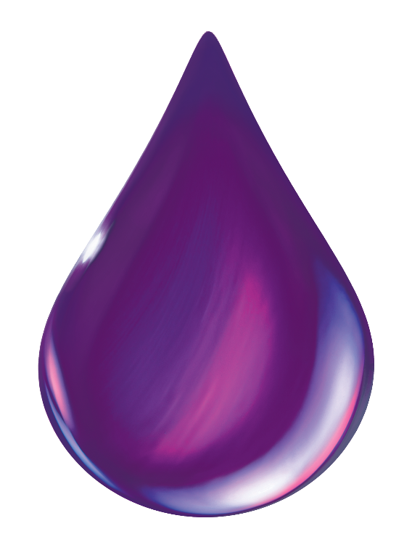
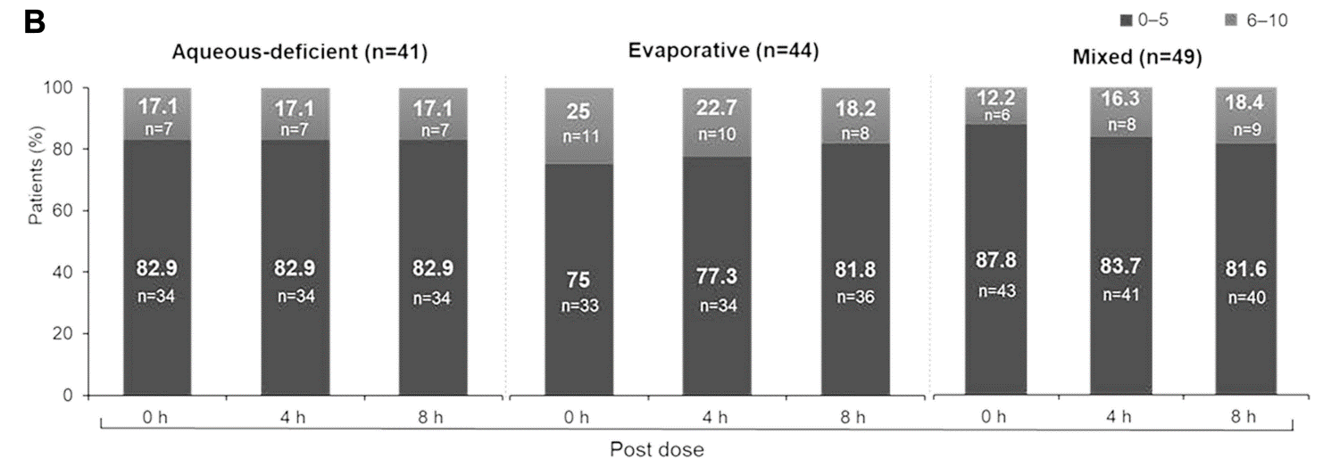
To improve patient’s ocular comfort (Soothing Sensation Scores)
Over 80% of patients reported Soothing Sensation through 8hr after a single dose of Systane Complete¹*
80%
Clinical Ophthalmology 2020:14 3167–3177. doi:10.2147/OPTH.S263362.
Notes:
To improve patient’s ocular comfort (Soothing Sensation Scores)

Slide 9
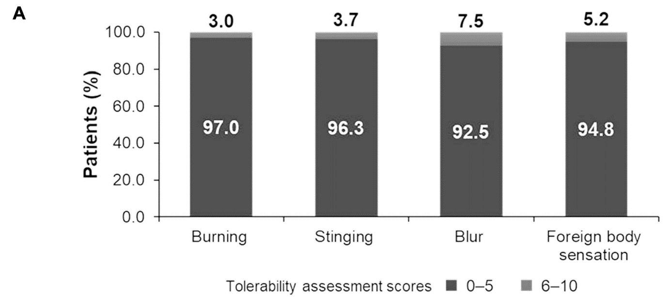
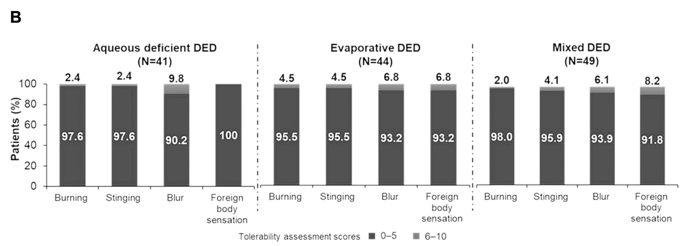
To minimize dissatisfaction (Tolerability Assessment Score)
Well tolerated with very few dissatisfaction
smaller nano-sized lipid droplets make the emulsion formulation less opaque, improving ocular surface coverage and minimizing blurring
Clinical Ophthalmology 2020:14 3167–3177. doi:10.2147/OPTH.S263362.

Slide 10
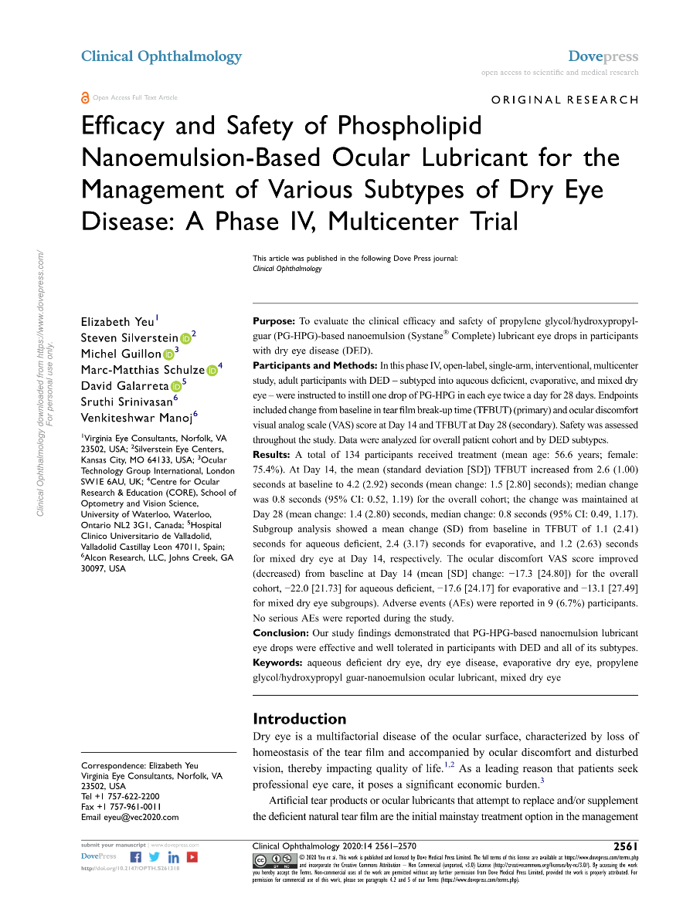
Efficacy and Safety of Phospholipid Nanoemulsion-Based Ocular Lubricant for the Management of Various Subtypes of DED
To evaluate the clinical efficacy and safety of propylene PG-HPG-based nanoemulsion (Systane® Complete) lubricant eye drops in participants with dry eye disease (DED)
134 adult participants with DED –divided into 3 subtypes
Instilled 1 drop to each eye twice a day for 28 days
Visited at Day 1 , Day 14 , Day 28
Systane Complete ( PG – HPG based nanoemulsion)
Tear film break-up time (TFBUT), ocular discomfort VAS score
Clinical Ophthalmology 2020:14 2561–2570. doi:10.2147/OPTH.S261318.

Slide 11
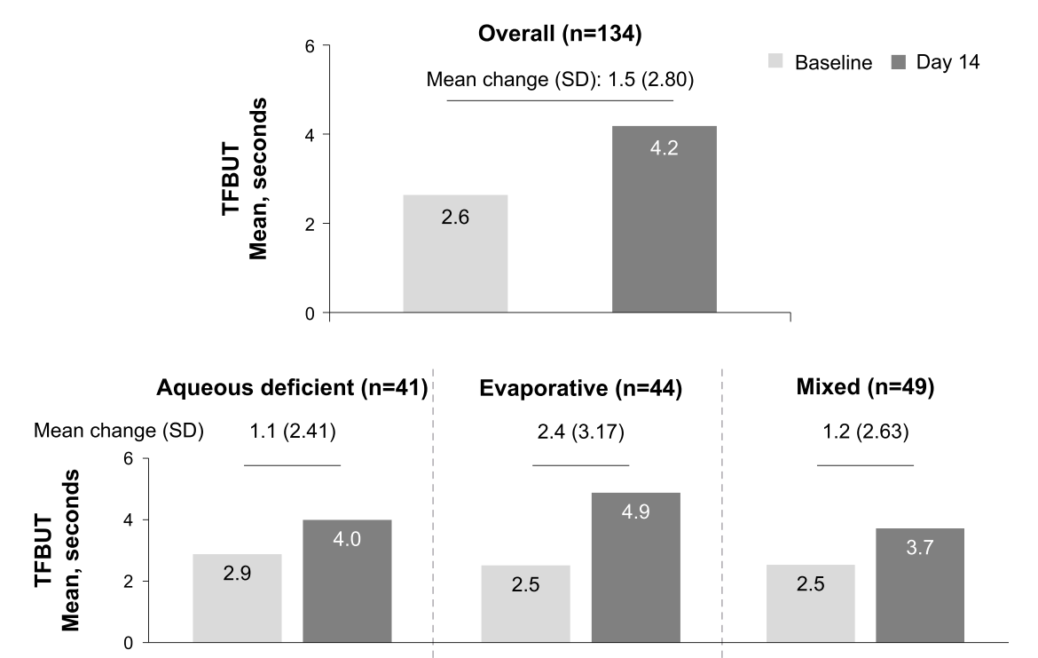
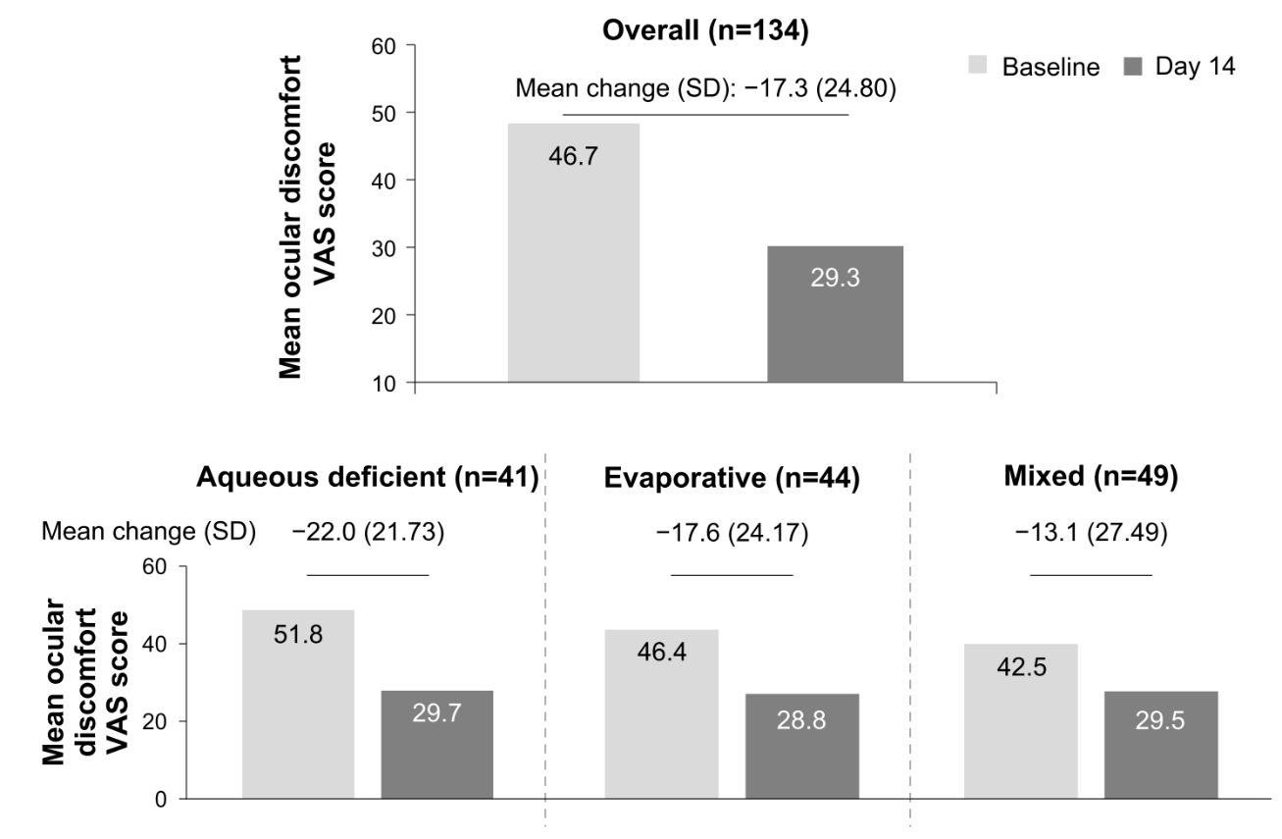
To return the ocular surface and tear film to the normal state
14-Day Change in Tear Breakup Time
14-Day Change in Ocular Discomfort VAS Score
References:Efficacy and Safety of Phospholipid Nanoemulsion-Based Ocular Lubricant for the Management of Various Subtypes of Dry Eye Disease
Clinical Ophthalmology 2020:14 2561–2570. doi:10.2147/OPTH.S261318.
Notes:
整體來看，14天後就很明顯提升了TFBUT
細看3種type，14天後也都明顯提升了TFBUT，尤其是缺油型真的改善許多

Slide 12
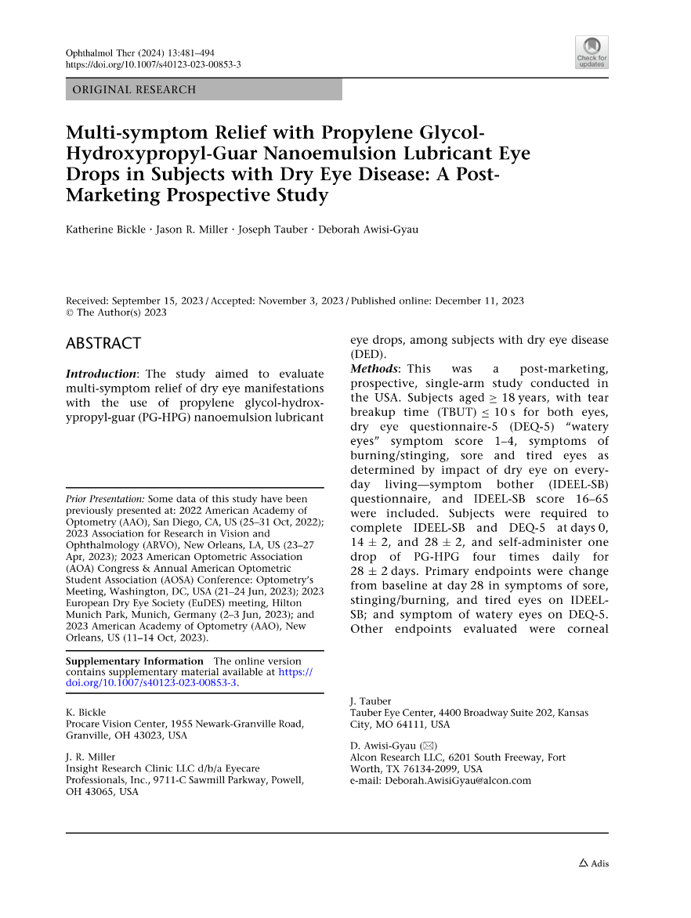
Multi-symptom Relief with PG-HP-Guar Nanoemulsion Lubricant Eye Drops in Subjects with DED - Post-Marketing
To evaluate the multi-symptom relief (sore, watery, stinging, burning, and tired eyes) of dry eyes with the use of PG-HPG nanoemulsion lubricant eye drops
Of 119 adult subjects enrolled, 95 completed the study
First dose at day 0, self-administer one drop QID for 28 ± 2 days
Visited on Day 0 , phone call on Day 14 , f/u visit on Day 28
Systane Complete ( PG – HPG based nanoemulsion)
Evaluated by IDEEL-SB & DEQ-5 scores at day 28
Ophthalmol Ther (2024) 13:481–494. doi:10.1007/s40123-023-00853-3.

Slide 13
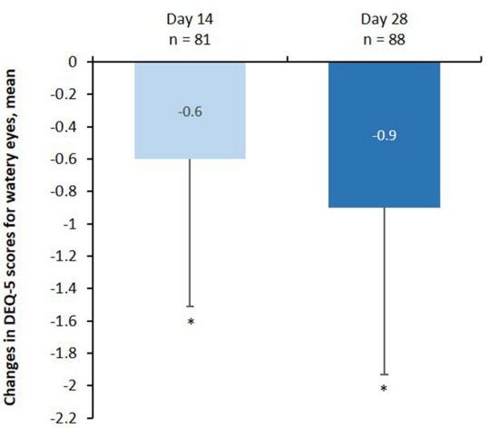
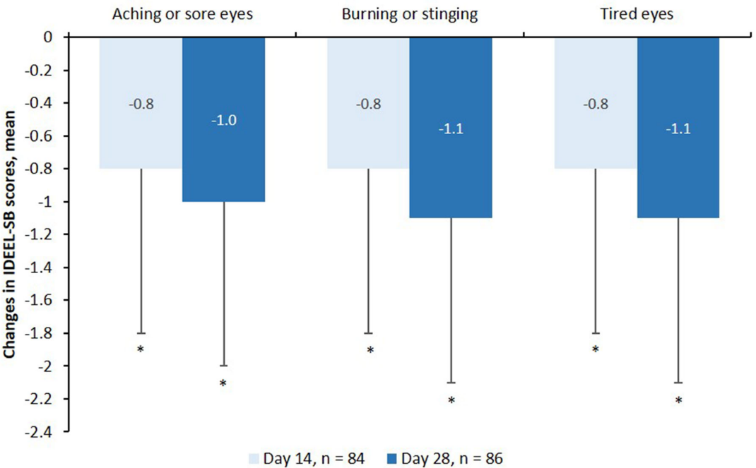
To improve symptoms of aching/sore, burning/stinging, tired eyes, or watery eyes
Changes in IDEEL-SB scores for dry eye symptoms
Change in DEQ-5 scores for watery eyes symptom
Ophthalmol Ther (2024) 13:481–494. doi:10.1007/s40123-023-00853-3.

Slide 14
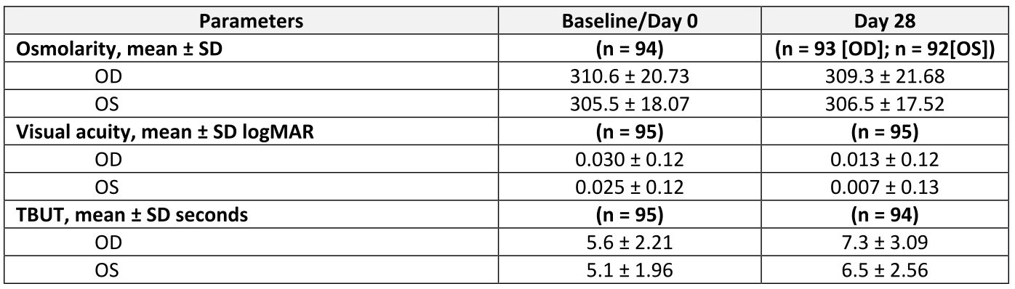

To improve tear ﬁlm stability
Ophthalmol Ther (2024) 13:481–494. doi:10.1007/s40123-023-00853-3.

Slide 15




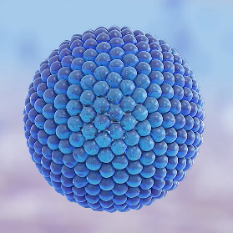
Overall Summary
Systane® COMPLETE is a Propylene-Glycol/HP-Guar/Nano-sized lipid artificial tear formulation¹
Systane® COMPLETE works on all layers of the tear film¹ and provides hydration and protection of the ocular surface for 8 hours^{1,2}
Systane® COMPLETE lubricant eye drops offer all-in-one relief, for all types of Dry Eye²
HP-Guar
Increases mucous layer thickness and protects the ocular surface^{1,3}
Nano-sized lipid droplets
Replenish the lipid layer of the tear film.¹
References: 1. Rangarajan R, Ketelson H. Preclinical evaluation of a new hydroxypropyl-guar phospholipid nanoemulsion-based artificial tear formulation in models of corneal epithelium. J Ocul Pharmacol Ther. 2019;35(1):32-37. 2. Silverstein S, Yeu E, Tauber J, et al. Symptom Relief Following a Single Dose of Propylene Glycol-Hydroxypropyl Guar Nanoemulsion in Patients with Dry Eye Disease: A Phase IV, Multicenter Trial. Clin Ophthalmol. 2020;14:3167-3177. 3. Davidson Z. Developing an Efficient Ophthalmic Device Combination Product. ONdrugDelivery Magazine. 2020;104:16-19.
See instructions for use, precautions, warnings and contraindications.
©2021 Alcon IMG-SYX-2100027
Notes:
總結
Complete不僅含有保濕因子PG能補足水層，HP-Guar還有增厚黏液層穩定淚膜結構的功能，最重要的是奈米油滴能更有效地填補Lipid layer
針對淚膜的3層都有實質功效，並提供長達8小時的保濕潤滑效果
Complete適用於所有類型的DED患者

Slide 16
補充

Slide 17
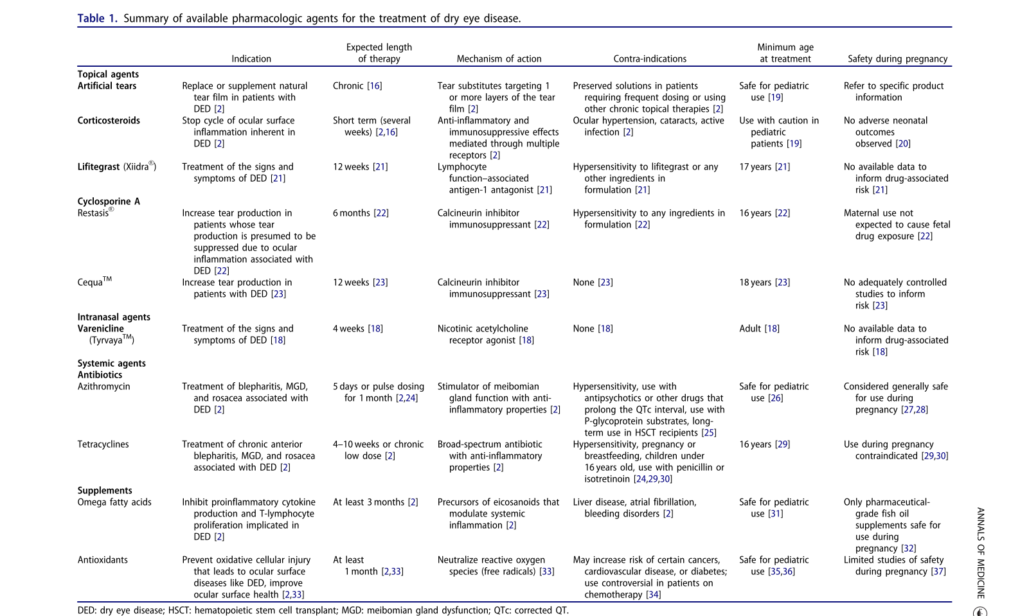
Ann Med. 2023 Dec;55(1):241-252. doi: 10.1080/07853890.2022.2157477.
Notes:
Ann Med. 2023 Dec;55(1):241-252. doi: 10.1080/07853890.2022.2157477.

Slide 18
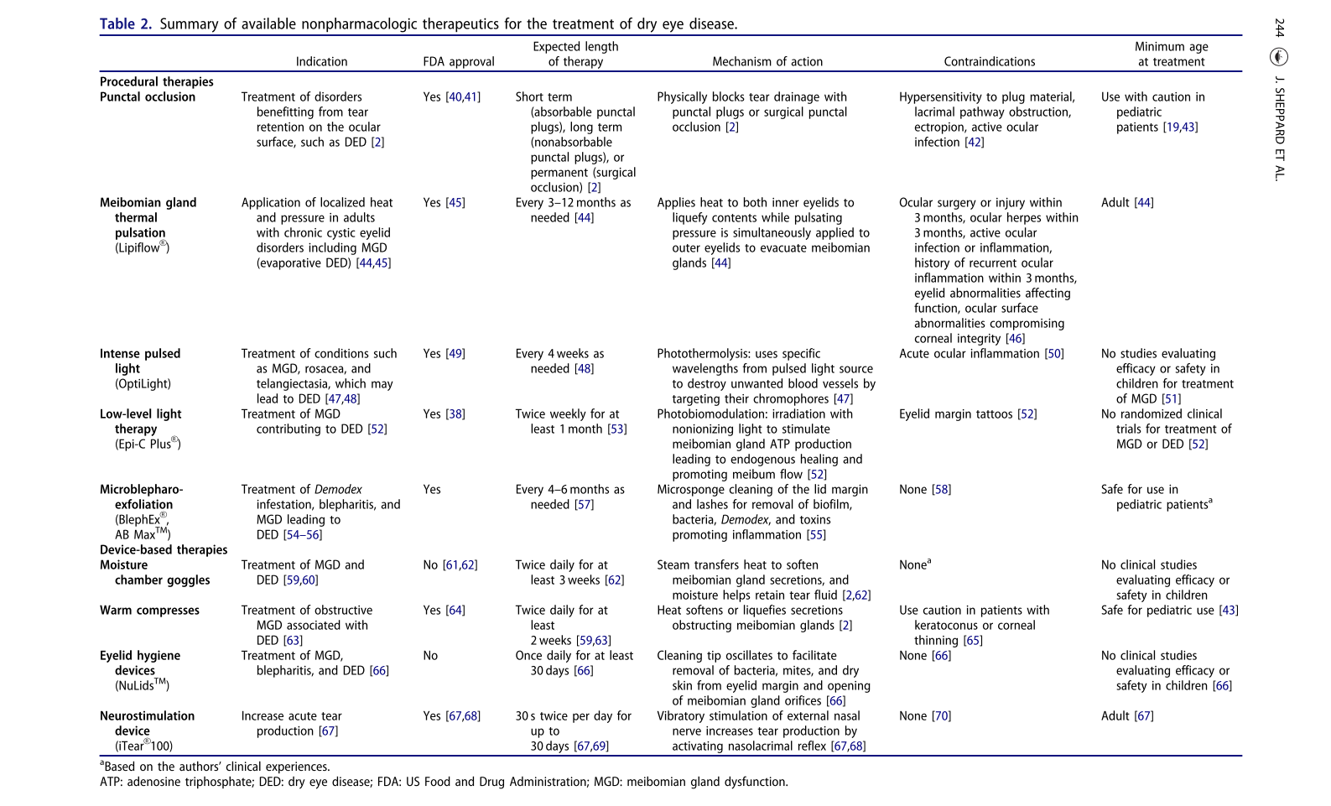
Ann Med. 2023 Dec;55(1):241-252. doi: 10.1080/07853890.2022.2157477.
Notes:
Ann Med. 2023 Dec;55(1):241-252. doi: 10.1080/07853890.2022.2157477.

Slide 19
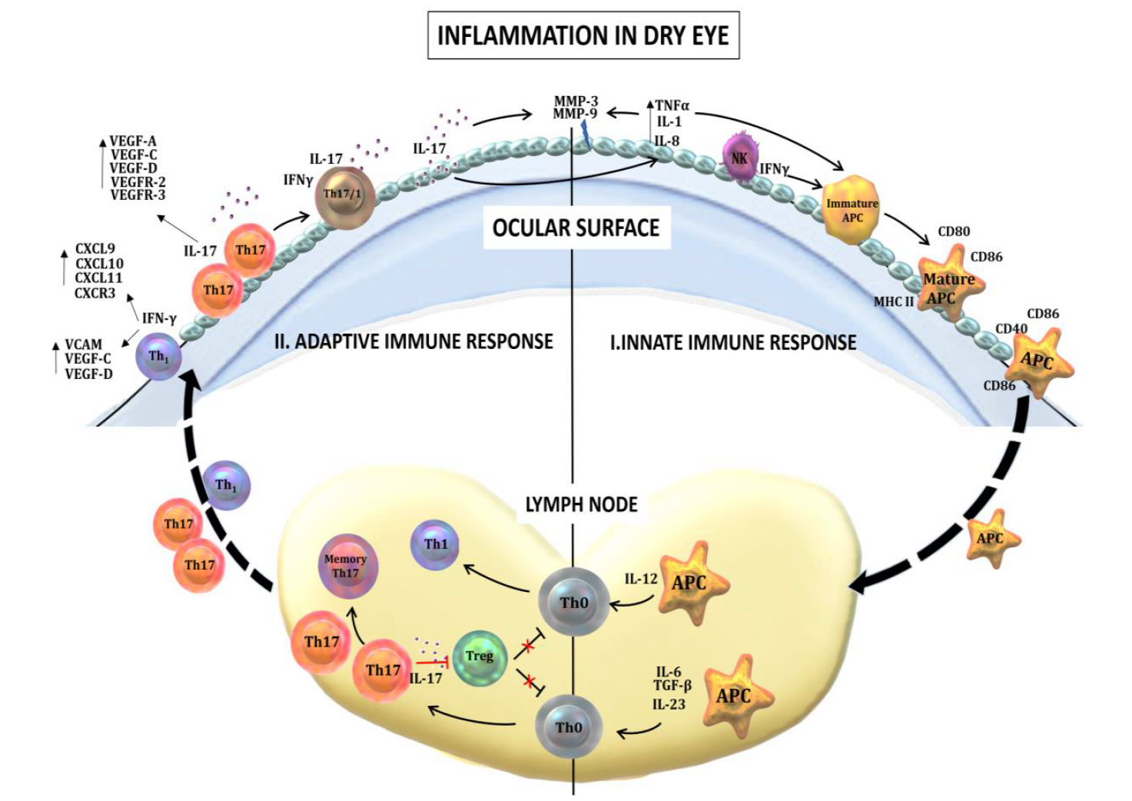
Int J Mol Sci. 2020 Dec 4;21(23):9271. doi: 10.3390/ijms21239271.

